Slide 1
The Wind Drum
Episode V: Nature strikes back!

Slide 2
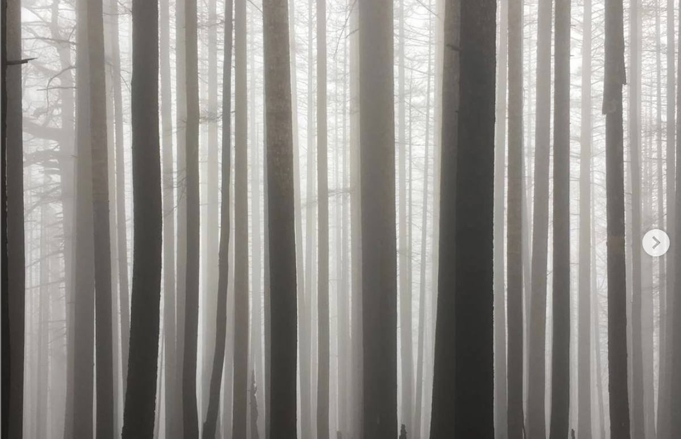
presentation 101 STUDIO INSTRUMENTARIUM // SP 2020
EVOCATIVE IMAGE
This is a single image that shows a clear image that evokes the soul of your project. This image helps set up the why in a compelling way, sets the stage for your narrative, and will help frame the entire presentation. The caption of this slide (set with the Edit Captions button when editing your post) should discuss the context of your project. No Text on the slide.

Slide 3
presentation 101 STUDIO INSTRUMENTARIUM // SP 2020
THESIS
The wind drum, when not being played, is meant to give nature the agency to make its own artificial noise, as a way of striking back at todays ultra-urbanized society.

Slide 4
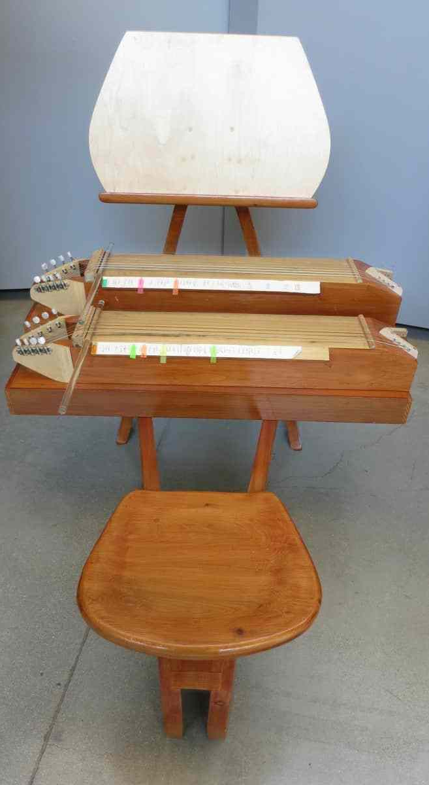
Wind Chimes
Surrogate Kithara
Piano
Precedents
They live in a space where there is no need for people to come near.
VERSATILE
SIMPLE
Originally planned for there to be glass resonators. Also a stringed instrument.
NOT TUNE CONFORMANT
For this i wanted the components to be struck by a hammer or mallet, like a piano.
PHYSICAL INTERACTION

Slide 5
Tyler the Creator
Composer

Slide 6
Facts
Worked on the grinch movie
Was banned from the UK for 3-5 years
One of the founders of Odd Future, a rap/fashion collective
Grew up in california and skated with his friends a lot
Listens to music slowed down.

Slide 7
First Album
Was on the group album “The Odd Future Tape” in 2008,
Debut solo album came out in 2009, with many instrumentals produced by himself.

Slide 8
Style
Started out as very aggressive shock rap and transitioned into a much more varied sound closer in style to pop.
Songs like Yonkers have very aggressive clipping drum patterns and driving screeches.
Songs like 911/Mr. Lonely much closer resemble a pop song.
Songs like Igor’s Theme are electronic instrumentals.

Slide 9
Favorite song
911/Mr. Lonely
Amazing display in dissonance between musical tone and lyrical content.
Self described as the “happiest depressing song of my career”

Slide 10
Rap/Hip Hop
Genre

Slide 11
5 Key facts
Many subdivisions of it, including Gangster Rap, Conscious Rap, Braggadocio Rap, Boom-Bap, Cloud Rap, Trippy Rap, Rock-Rap, Jazz Rap, Trap, Glitch Hop, Drill, Experimental Rap, and Lofi Rap.
Primarily African-American and Latino genre, with a few notable exceptions (Mac Miller, Eminem, El-P, G-Eazy to name some)
Can typically be taxonomized by location (ie. West Coast, East Coast, New York, Atlanta, Chicago Drill, and UK Drill)
Can be characterized into waves, usually 4-5.
Roots in spoken word poetry.

Slide 12
Defining Characteristics
Someone paradoxically its defining characterization is its versatility.
Usually a single person or duo trading lines over a drum heavy instrumental, with usually not more than 2 instrumental leads and a bassline, prominent use of samples too.
During the late 80’s and 90’s the sound was defined by the Roland 808 Drum Machine, which included entirely artificial samples, including a kick drum whose sustain could be turned up, and which now, when tuned, provides the bassline for many modern day instrumentals.
Subject matter can range from drugs (Juice Wrld, Future) to violence (XXXTentacion, 6ix9ine) to escaping poverty (Kendrick Lamar, Denzel Curry) to gang affiliations (Blueface, Nipsey Hussle, YG, Roddy Ricch)

Slide 13
Origins
Originated in the Bronx in the 70’s, but didn’t gain radio play until 1979.
Most people agree that freestyle rap originated with DJ Cool Herc and Grandmaster Flash extending the instrumental bridges in songs to let clubgoers dance more, and people began rhyming on top of these extended instrumentals.
The Sugarhill Gang's song Rapper's Delight is generally accepted to be the first hip hop song to gain mainstream popularity and where hip-hop got its name.

Slide 14
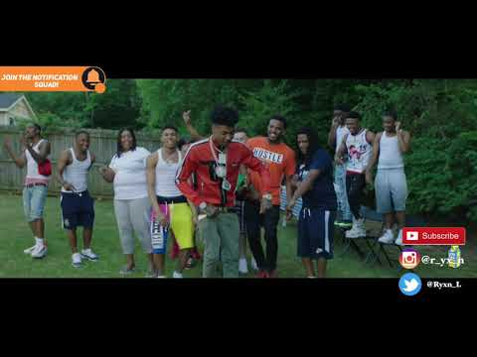
Listen for resonant Kick drums (808’s), few melodic components, and subject matter

Slide 15
Wintergatan Marble Machine
Instrument

Slide 16
5 Facts
Process documented on youtube
Swedish Band’s Brainchild
Building it took 2 years
Uses over 2000 marbles
Can be reconfigured to play different instruments and songs.

Slide 17
Materials
Wood
Marbles
Drums
Parts of tuned strumming instruments
Belts to turn wheels and such

Slide 18
How its played
By turning a wheel you start the machine which goes through phases
You can also release marbles manually onto certain instruments

Slide 19
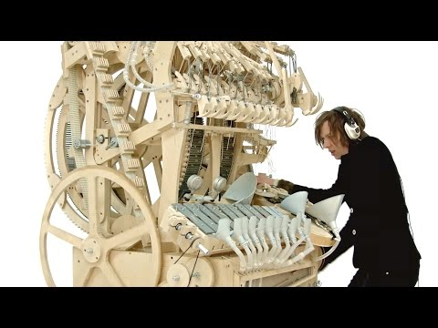

Slide 20
Resources

Slide 21
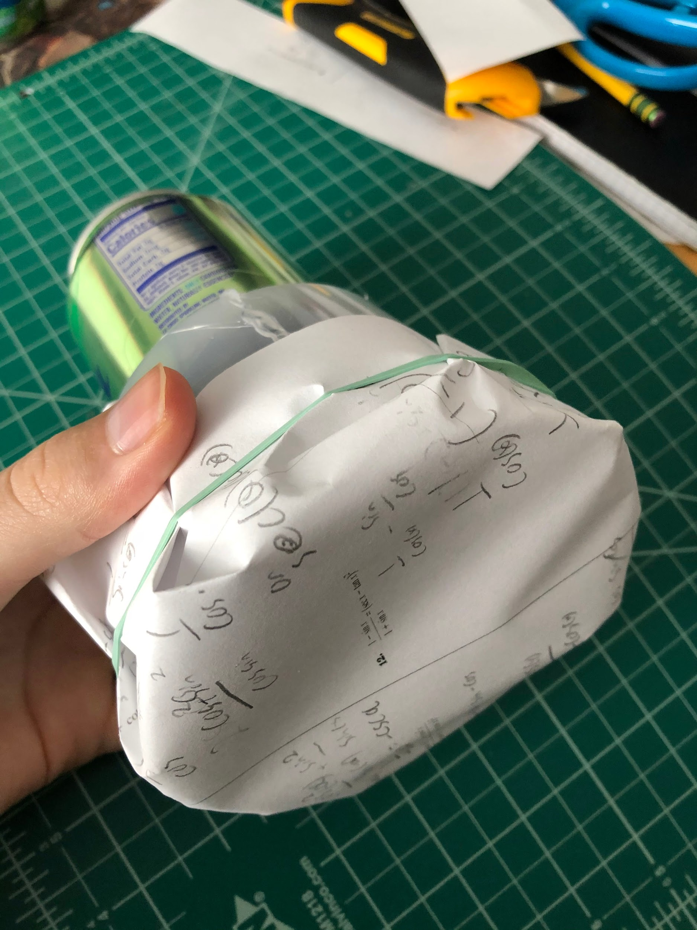
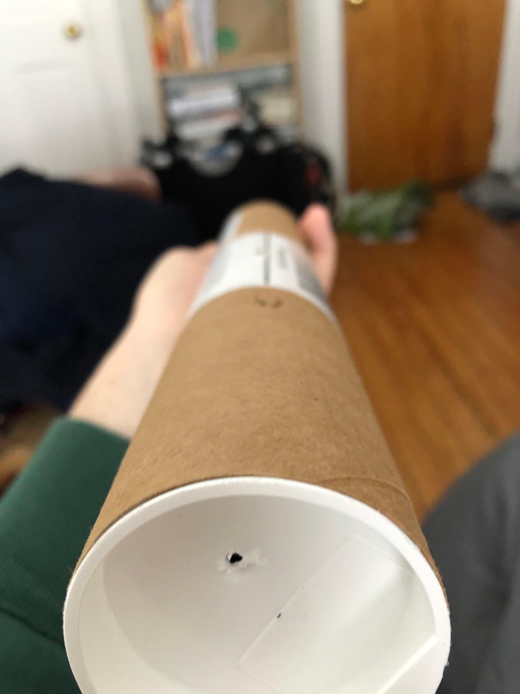
presentation 101 STUDIO INSTRUMENTARIUM // SP 2020

Slide 22
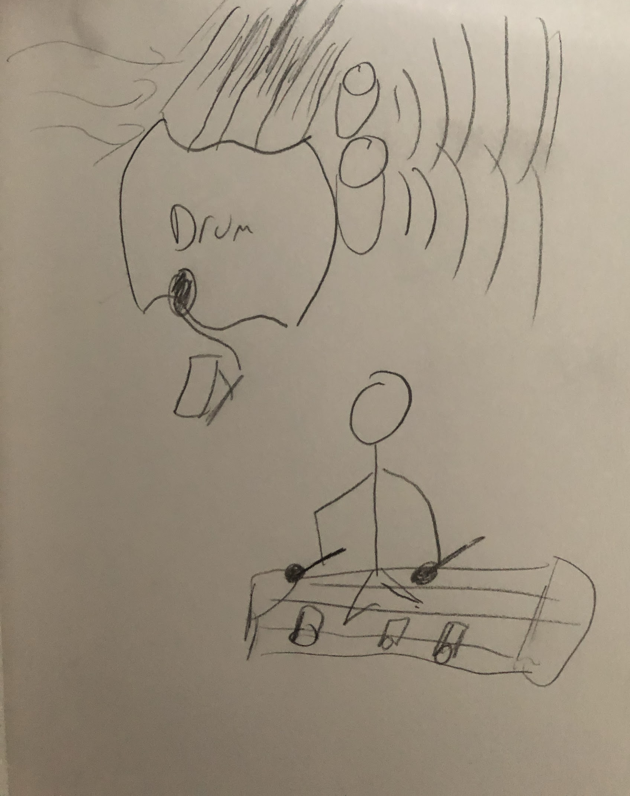
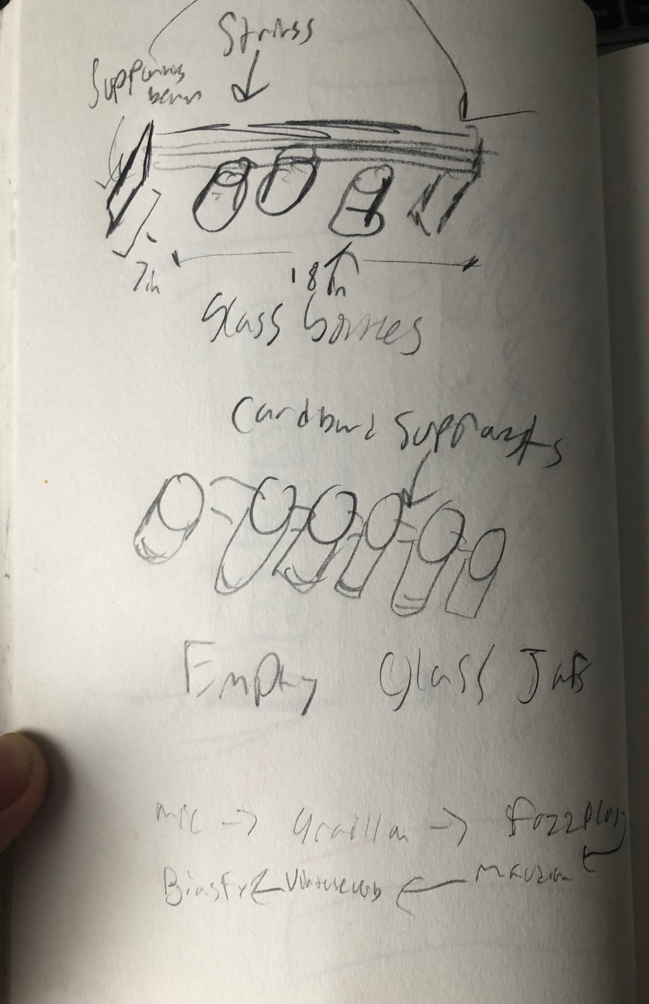
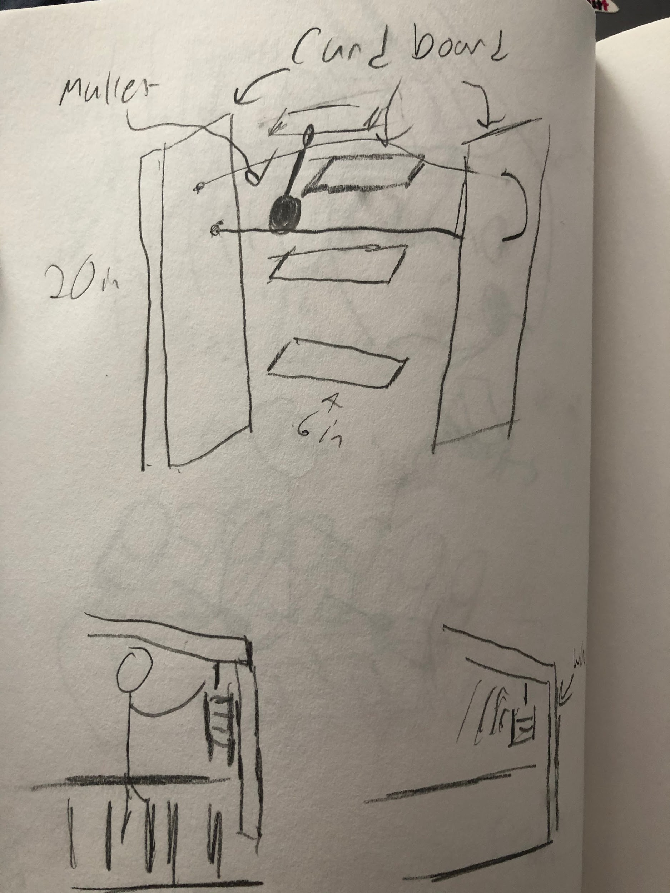
presentation 101 STUDIO INSTRUMENTARIUM // SP 2020
DOODLES

Slide 23
presentation 101 STUDIO INSTRUMENTARIUM // SP 2020
STORYBOARD DIAGRAMS

Slide 24
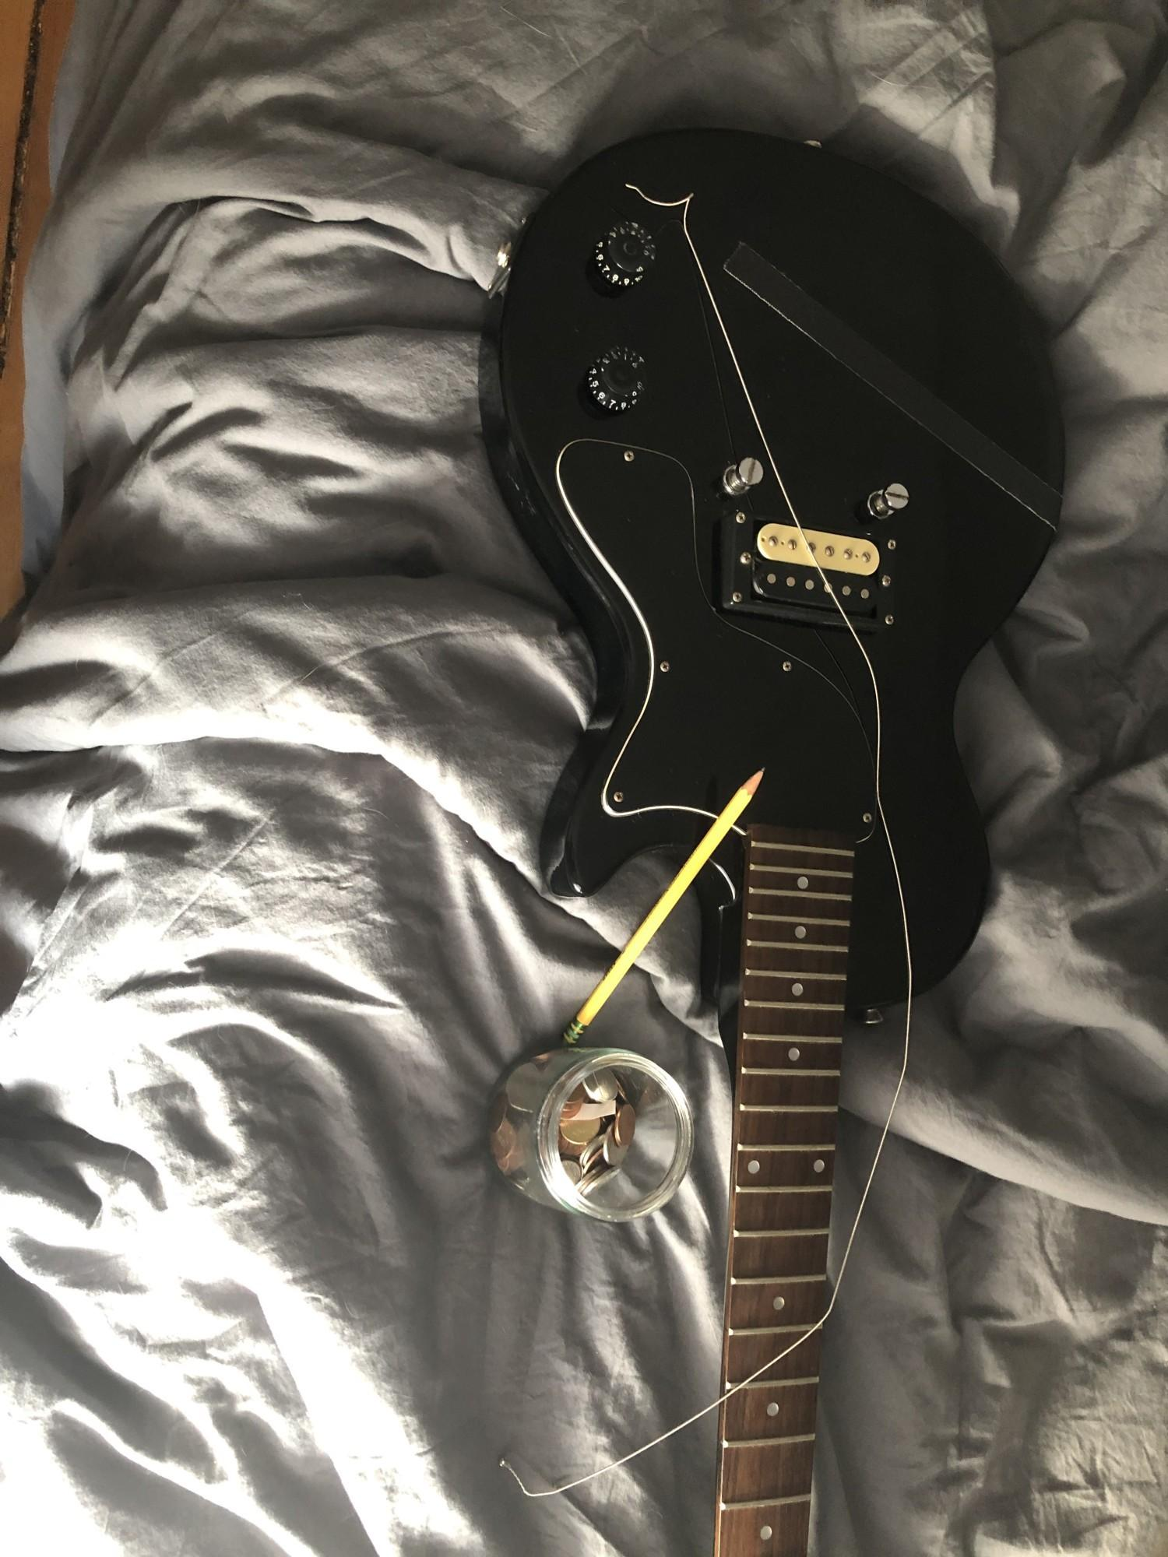
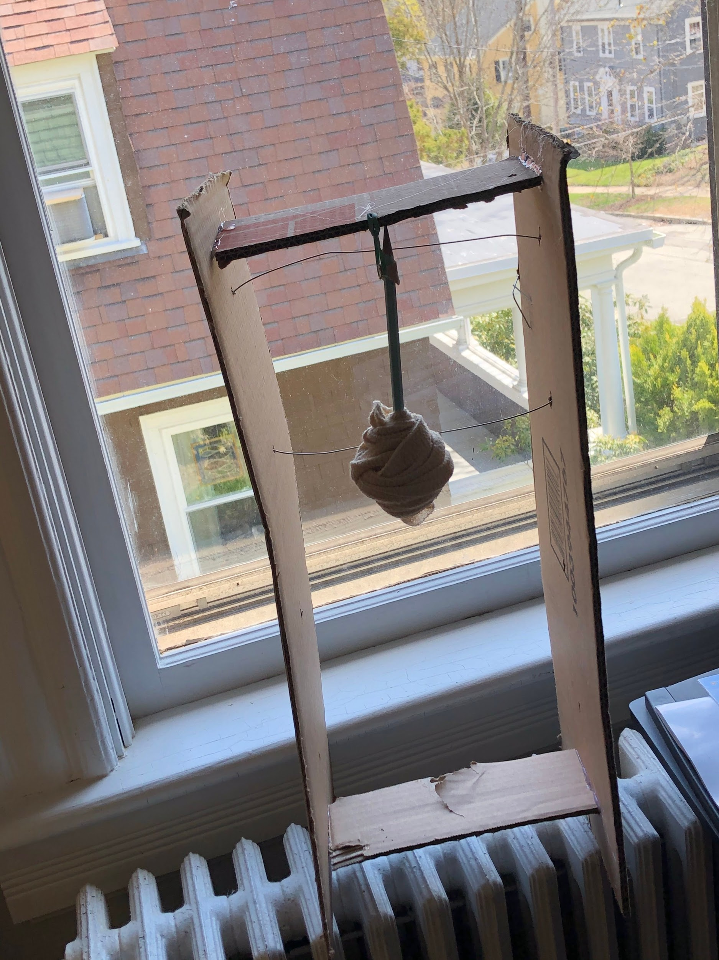
presentation 101 STUDIO INSTRUMENTARIUM // SP 2020
PROTOTYPE IMAGE (s)

Slide 25
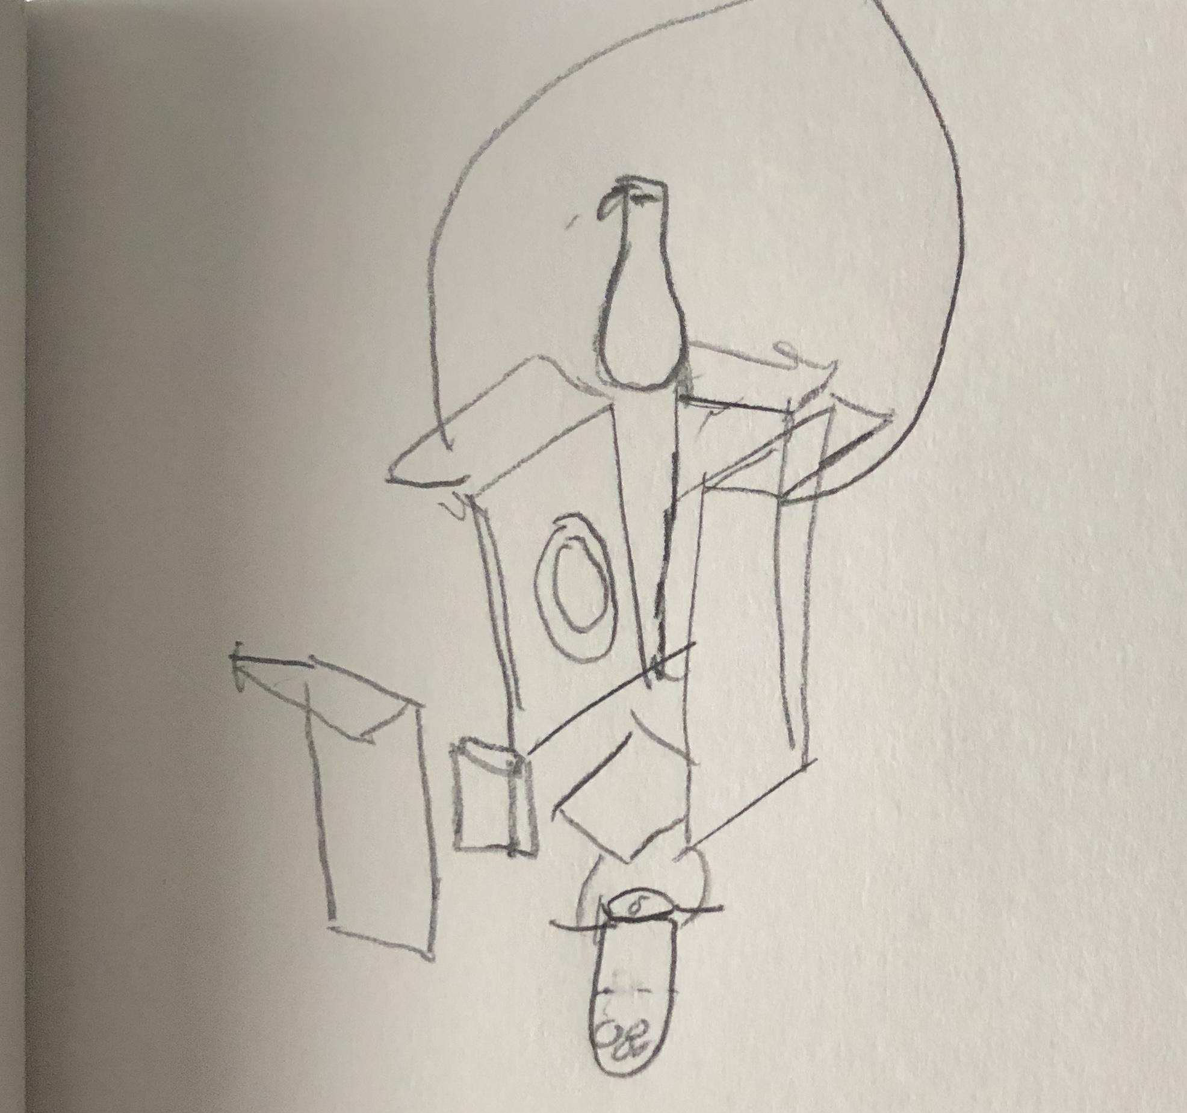
MATERIAL LIST + DIAGRAM
Materials
Large cardboard box
Smaller food box
Old can
Paper Clips
Rubber Bands
Empty Bottle of sparkling water
Coins

Slide 26
Music is dead! Long live music!
Monotony is the silver handled knife in the back of unfettered creativity and self-expression. Long gone are the days of four on the floor and even time signatures. Why even have time signatures? The monotonous establishment requires it. Music is dead! Long live music.
Our sound is that of a return to nature. Our basslines will be the songs of whales, our kick drums trees being felled in the forest. The only way we can transcend the restrictions placed on us by society is by regressing from current perfectionist ideas of tune and time to the sounds of a pre-society earth. Music is dead. Long live music.
Metronomes serve no purpose in our new world. Restricting ourselves to notions of artificial beats per minute and time signatures are useless. All music is now to be regulated by ones heartbeat. If the music does not align and flow with the bumping of ones heart, do not consider yourself a Post-neo-reversionist. Music is dead.
Tuning forks are similarly useless. 440HZ? 500HZ? Leave numbers to the scientists and mathematicians. Precision and rigor has no place in music. When ideas of adhering to a predefined set of 4 bars or 8 bars enter the creative arts, we sacrifice all that makes creativity creative. Music is dead.
We only know primality. We only know nature. Long live music.

Slide 27
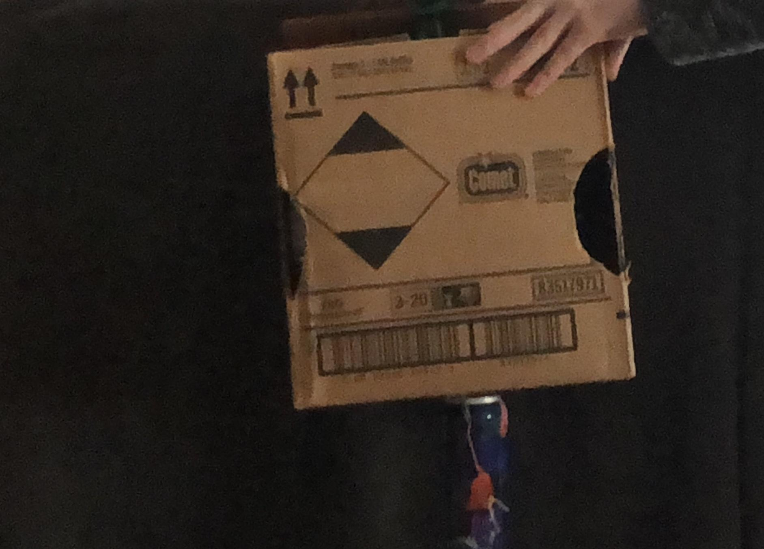
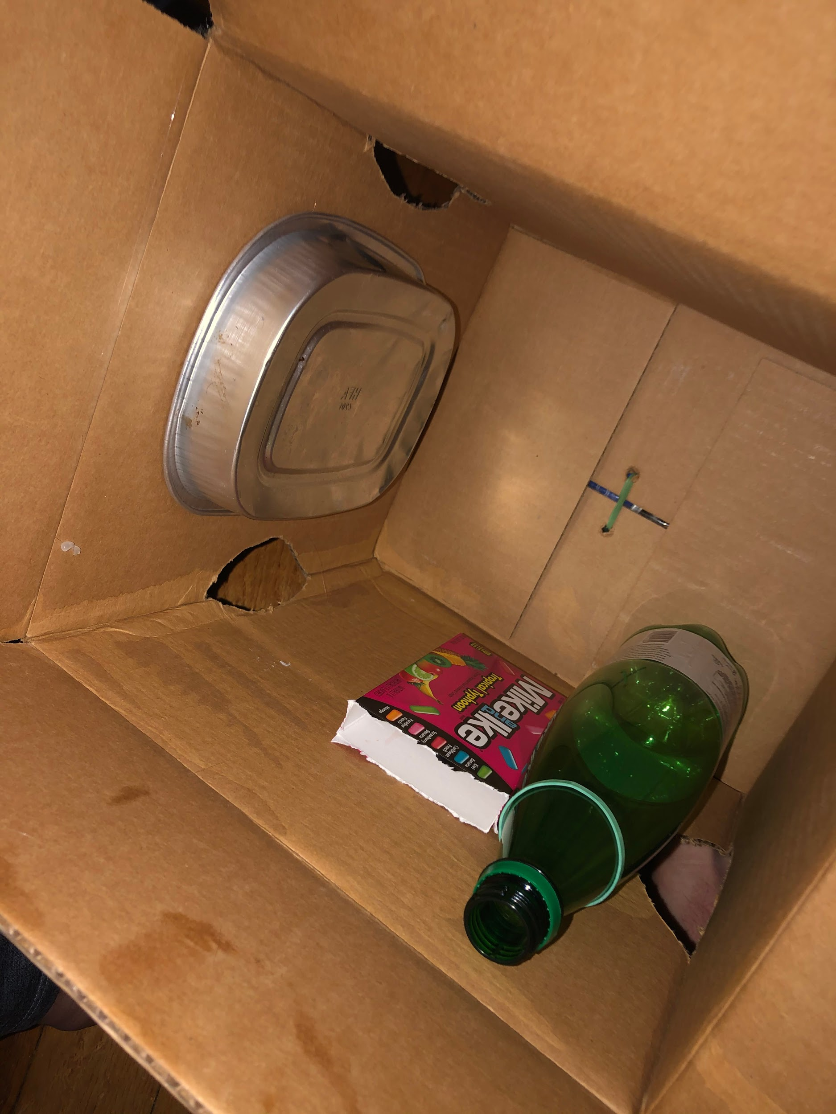
FINAL PROTOTYPE IMAGERY

Slide 28
presentation 101 STUDIO INSTRUMENTARIUM // SP 2020
Show video

